Slide 1



अनुkulanam
हर धागे में कहानी

Slide 2


About
“At अनुkulanam, we believe fashion should be inclusive, effortless, and personal.
We bring together semi-stitched garments, a professional tailor network, and QR-based digital styling tools to give every customer the perfect fit, confidence, and style.
By combining Indian tradition with modern technology, we simplify ethnic wear for today’s generation.”
US

Slide 3


“अनुkulanam was born from a realization that most people struggle with ill-fitting clothes, confusing styling choices, and the complexity of saree draping.
We wanted to change that. By merging India’s timeless traditions with modern technology and tailoring networks, we created a brand that empowers people to dress with comfort, confidence, and pride.”
Our
Story

Slide 4
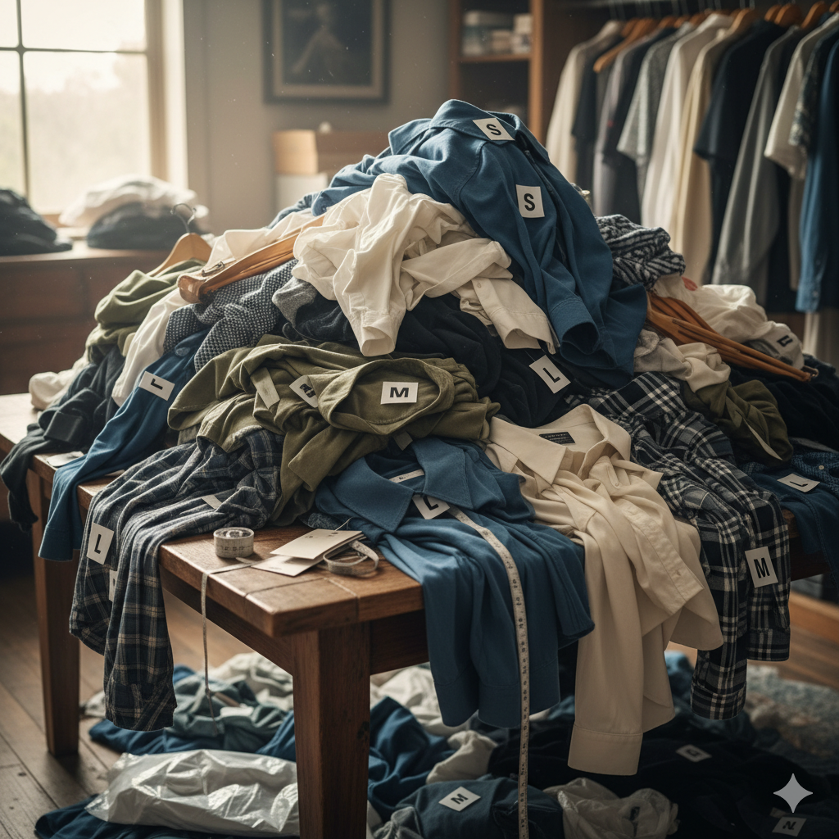
The
Problem
Fit issues: Many ready-to-wear brands ignore body diversity.
Style misinterpretation: Many customers don’t know how to match outfits.
Saree challenges: Draping and styling are barriers despite saree’s popularity.

Slide 5
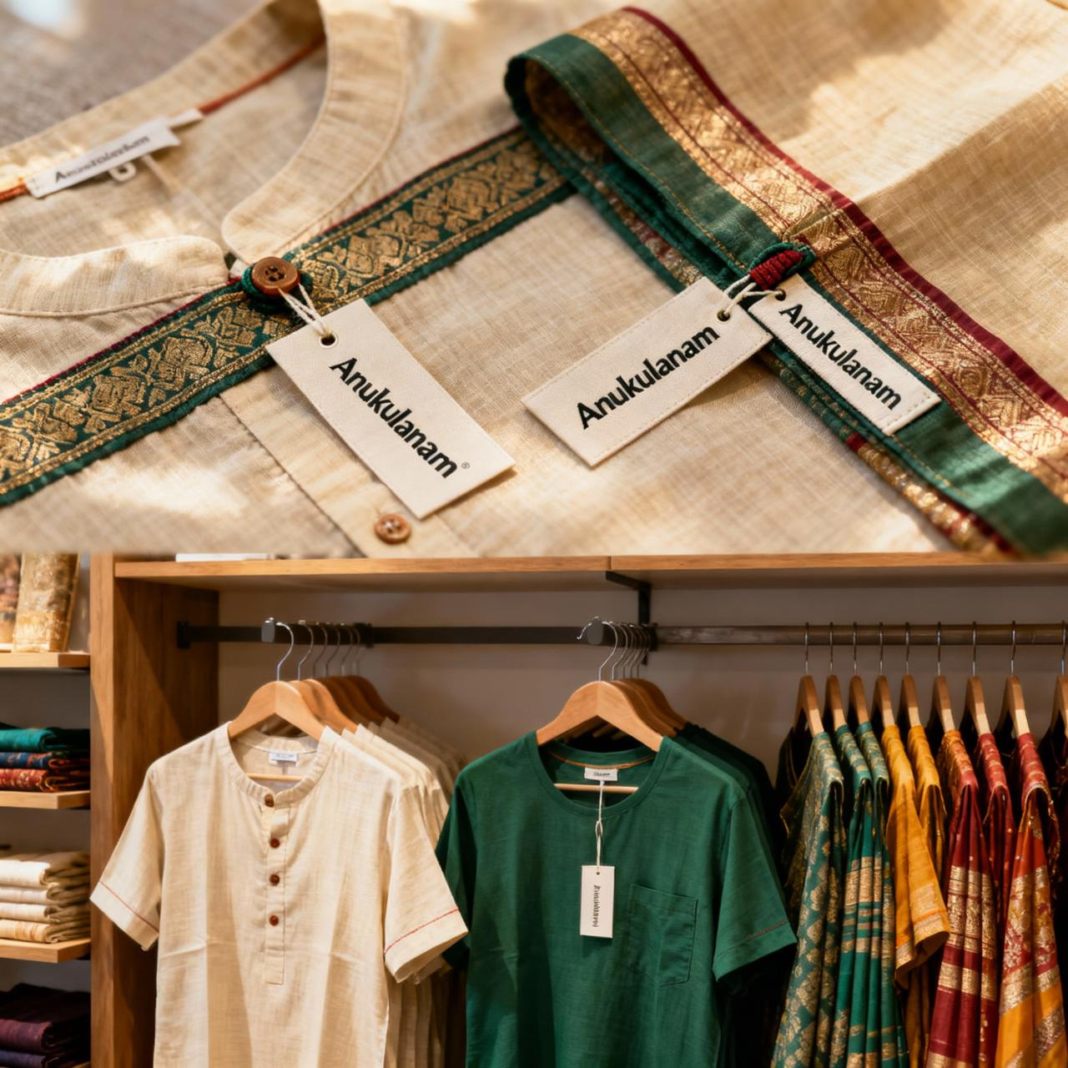
The
Solution
Semi-stitched apparel: Perfect customization through tailoring.
QR-powered styling: Personalized accessory, footwear, and jewellery suggestions.
Saree innovation: QR-enabled tutorials for draping and styling.
Buy–Stitch–Wear Model: Seamless link between customer, brand, and tailor.

Slide 6
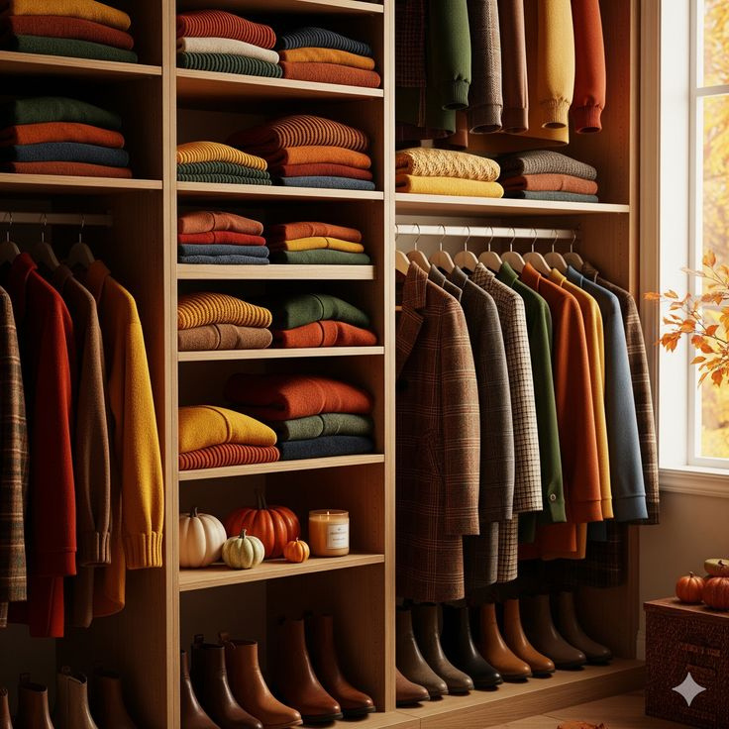
Our
Collection

Slide 7
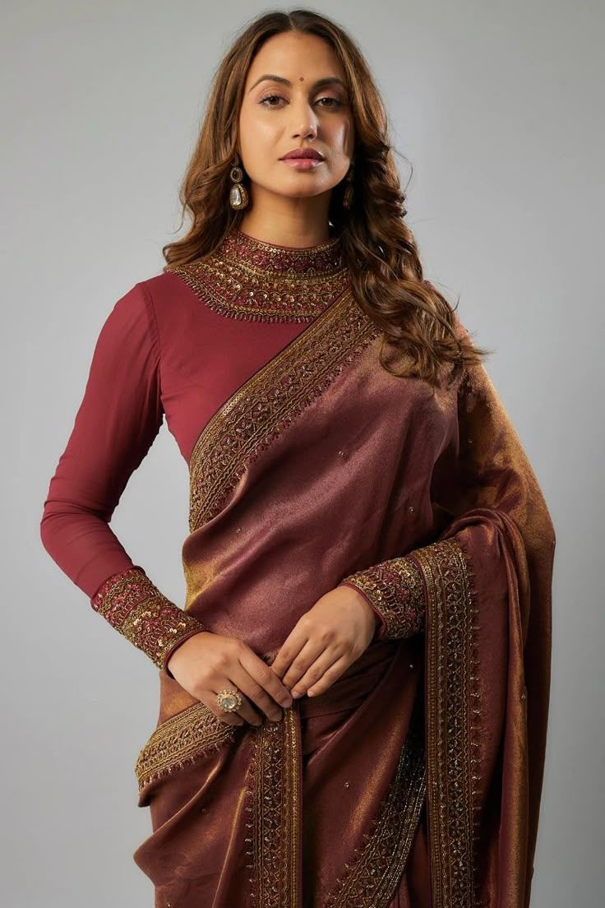
SAREE

Slide 8
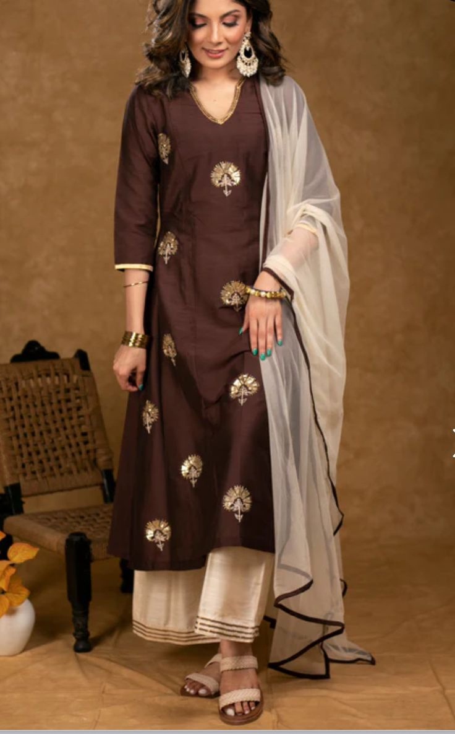
KURTI

Slide 9
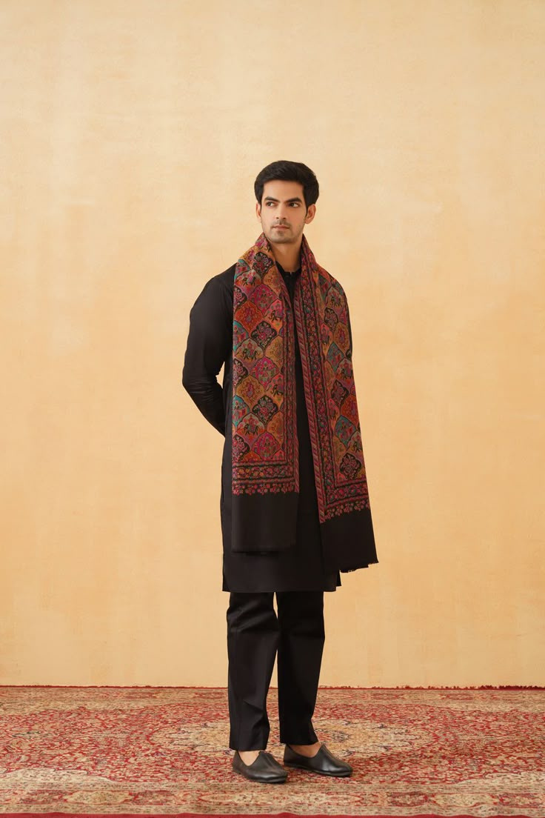
KURTA

Slide 10
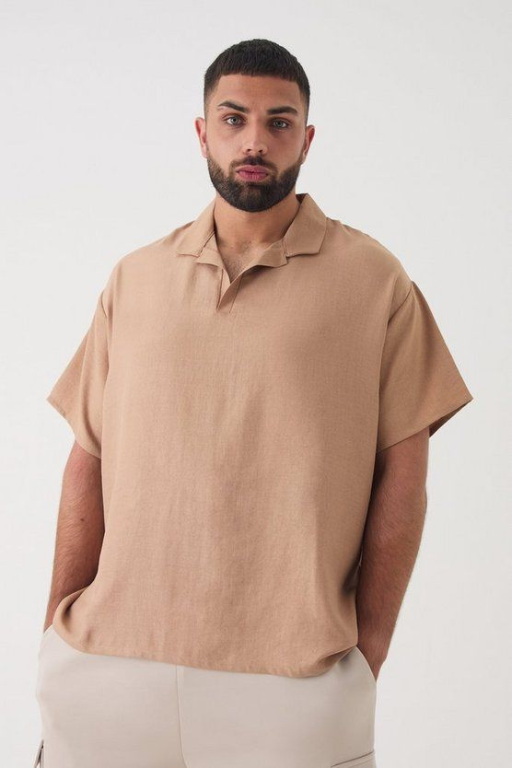
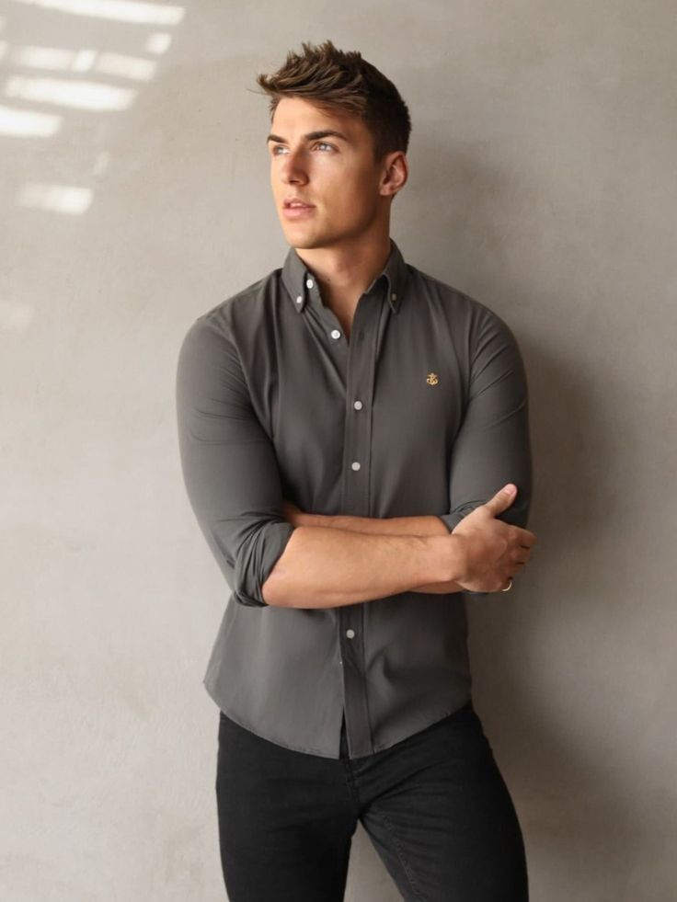

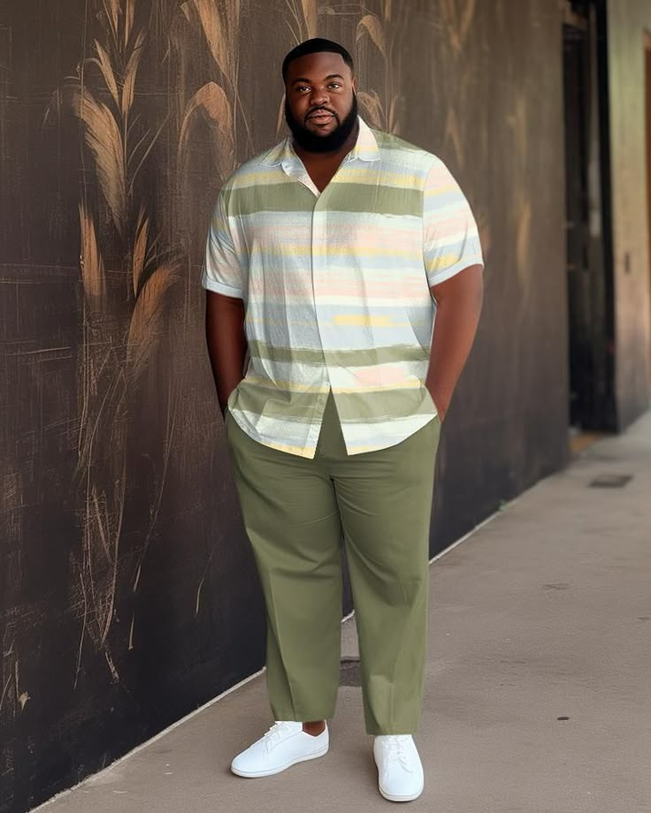
SHIRTS
&
T-SHIRTS

Slide 11

Target Market
Affluents (25–45 yrs, urban women/businessman) – Luxury sarees, exclusivity in shirts.
Value Seekers (20–35 yrs, urban & semi-urban youth) – Affordable style and good fit in daily and office wear.
Conservatives (35–60 yrs, semi-urban/rural) – Simplicity, durability, tradition for everyday use.
Segmentataion

Slide 12
Competition
Libas – Ethnic & fusion women’s wear.
Fabindia – Sustainable, handloom-focused.
BIBA – Mass market ethnic wear.
Manyavar/Mohey – Wedding-focused.
Our Edge: Personalization + tech integration + tailoring network.
Landscape

Slide 13
Marketing
Strategy
Online: Influencers, reels (#AnukulanamFitThatMatters), geo-targeted ads.
Community: #DesignWithAnukulanam contests, fashion shows, styling workshops.
Offline: Newspaper ads, billboards, tie-ups with local tailors.
Core Message by Segment:
Value Seekers: “Perfect fit, affordable style.”
Conservatives: “Tradition made simpler.”
Affluents: “Luxury that understands you.”
Customer Retention:
Personalized styling via WhatsApp/Email.
Family/festival group offers.
Loyalty points & referral bonuses

Slide 14
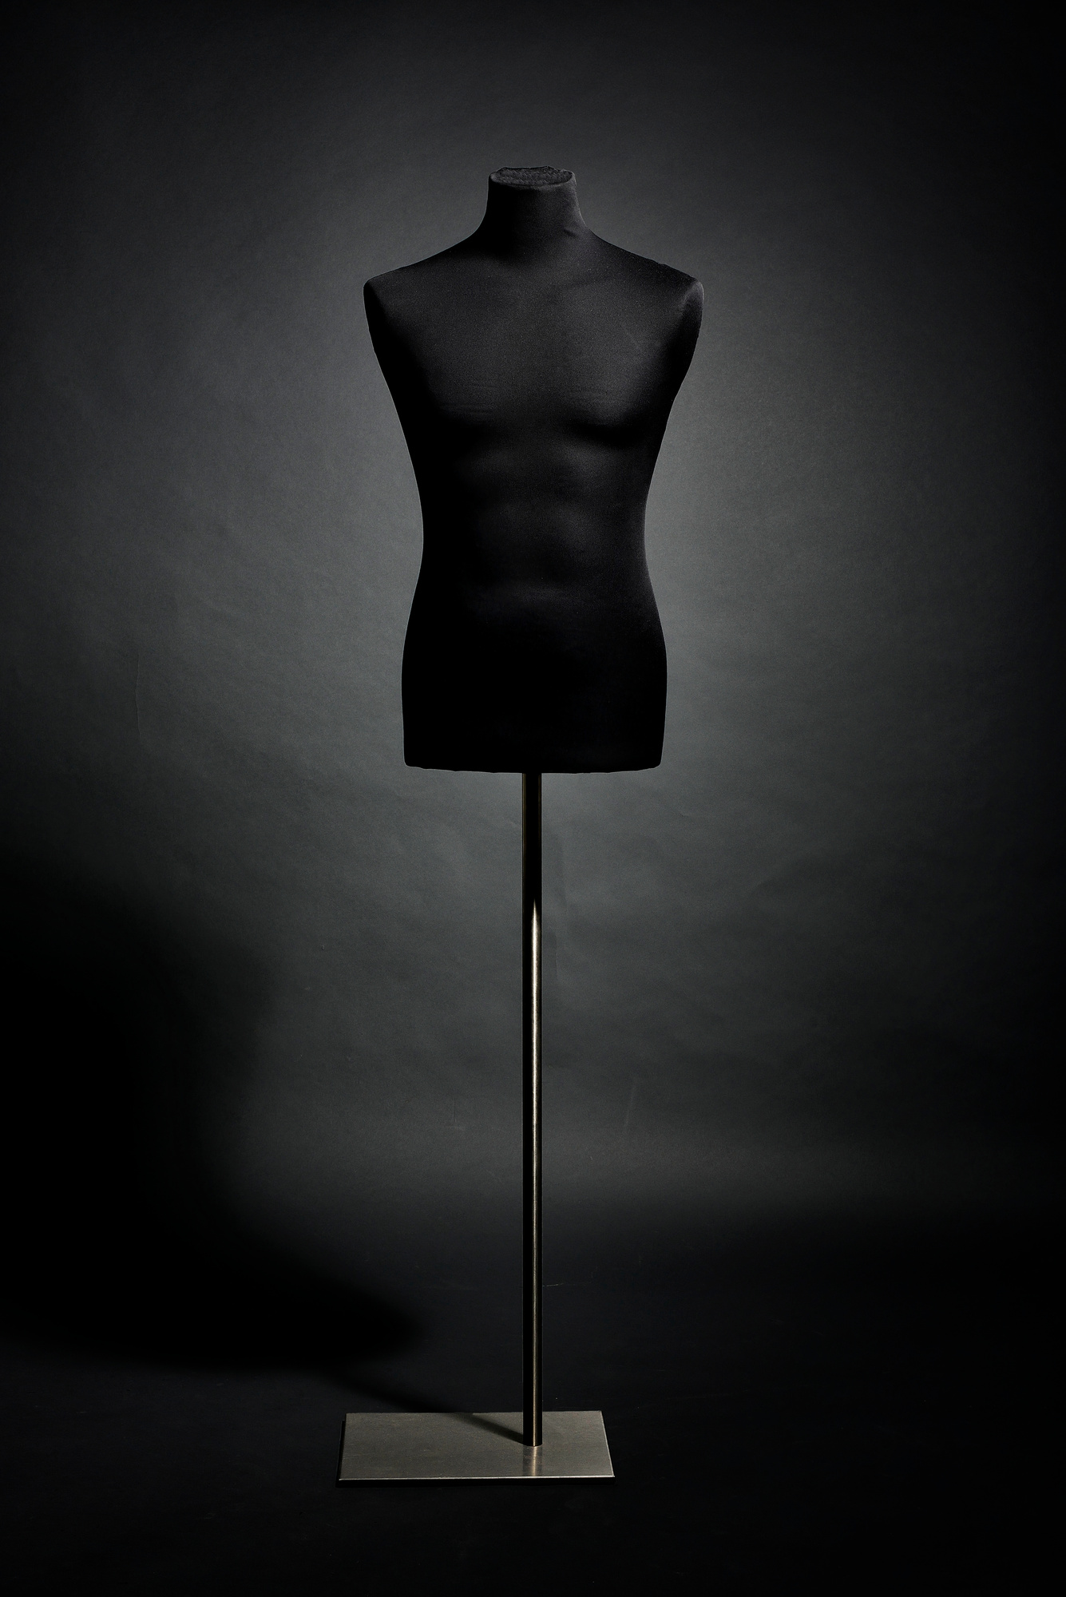
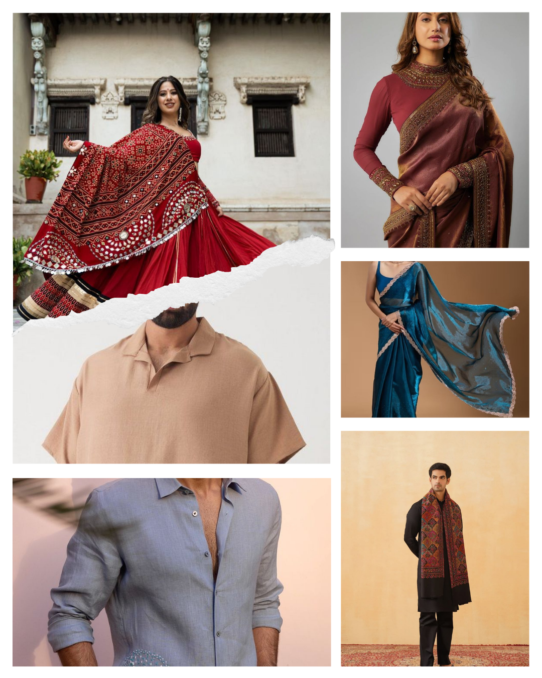



Contact
9327331817
Us
joshihemang25@gmail.com
http://127.0.0.1:5500/Website/index.html

Slide 15


Thank You

